Slide 1
ASTROSAGE PERFORMANCE DASHBOARD
Call Center Optimization & Investment Analysis
Submitted by: Suraj Kumar Jaiswal
Data Analysis Project | Investment: ₹1 Crore

Slide 2
PROBLEM STATEMENT
Business Context
AstroSage has received a ₹1 crore investment. The challenge is to decide where this investment should be allocated to maximize operational efficiency, customer satisfaction and profitability.
Operational Efficiency
Customer Satisfaction
Profitability
Call demand changes by day and hour. Workload must be matched with agent availability so peak periods are handled without unnecessary staffing during low-demand periods.
Overall average rating is about 2.93. Ratings vary by consultation type, platform and guru, creating clear areas for targeted service improvement.
Call is the dominant revenue-generating consultation type. Investment should protect this revenue stream while improving weaker service areas such as Chat.
Project Goal
Use historical call-center data and dashboard KPIs to prioritize training, technology, staffing and monitoring decisions.
2

Slide 3
DATA OVERVIEW
Records
Cleaned columns
Unique gurus
Unique users
Avg. rating
28,027
36
151
10,344
2.93
Customer & Consultation
Call, Chat & Financial
User, Rating & Analysis
• chatStatus – chat interaction status
• guruName – guru/agent name
• gid – guru ID
• uid – user ID
• consultationType – Call/Chat/category
• website – service platform
• refundStatus – refund outcome
• region – user region
• freeCall – free-call flag
• freeChat – free-chat flag
• chatSeconds – chat duration in seconds
• createdAT – record creation time
• updatedAt – last update time
• chatStartTime – chat start timestamp
• chatEndTime – chat end timestamp
• timeDuration – call/chat duration
• callChannel – call channel
• callIvrType – IVR type
• callStatus – call outcome
• CallSid – call identifier
• amount – transaction amount
• astrologerCallStatus – guru-side call outcome
• astrologerOnCallDuration – guru call duration
• astrologersEarnings – guru earnings
• netAmount – net revenue
• userCallStatus – user-side call outcome
• userOnCallDuration – user call duration
• rating – customer rating
• Date – analysis date
• Year – year extracted from Date
• Month – month extracted from Date
• Day – day extracted from Date
• Chat Started Month – chat month
• Hour – hour extracted for hourly analysis
• Rating_Level – rating band for analysis
• __v – record/version field
3

Slide 4
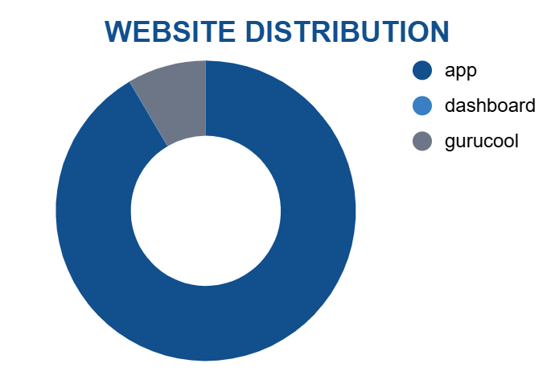
WEBSITE DISTRIBUTION
KEY INSIGHT 1
GuruCool is the dominant platform with 20,225 records (about 72.2% of the dataset).
KEY INSIGHT 2
App contributes 7,800 records (about 27.8%), making it the second-largest platform.
KEY INSIGHT 3
Dashboard has only 2 records, so platform activity is highly concentrated in GuruCool and App.
4

Slide 5
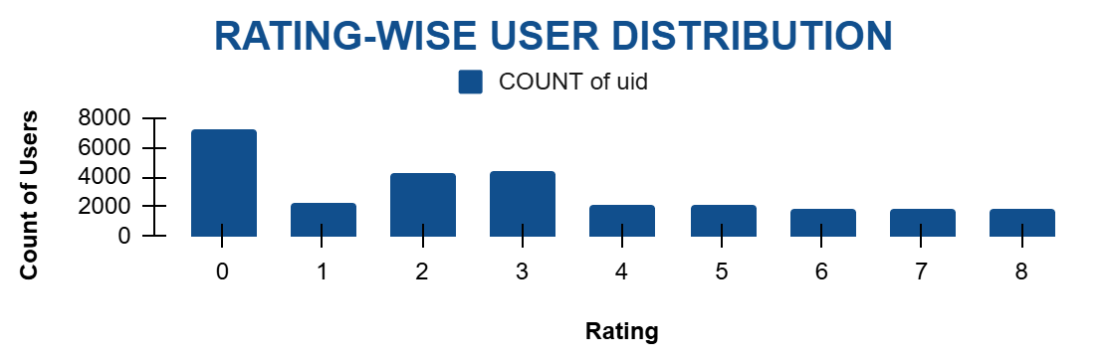
RATING-WISE USER DISTRIBUTION
KEY INSIGHT 1
KEY INSIGHT 2
KEY INSIGHT 3
Rating 0 has the largest user count at 7,256, showing a substantial low-rating segment.
Ratings 2 and 3 are also large groups, with 4,329 and 4,407 records respectively.
The distribution shows a wide spread of customer ratings, reinforcing the need for targeted service-quality improvement.
5

Slide 6
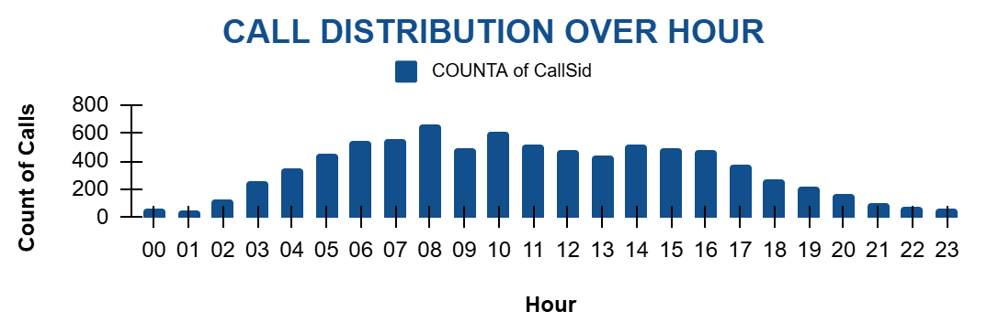
CALL DISTRIBUTION OVER HOUR
KEY INSIGHT 1
KEY INSIGHT 2
KEY INSIGHT 3
Call activity rises sharply from the early morning and reaches its highest volume around 08:00.
08:00 records about 1,875 interactions, the highest hourly volume in the cleaned data.
Demand falls after the evening peak and is lowest around midnight, supporting demand-based shift planning.
6

Slide 7
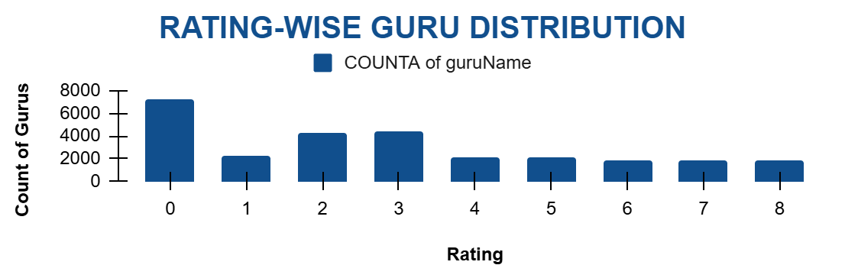
RATING-WISE GURU DISTRIBUTION
KEY INSIGHT 1
KEY INSIGHT 2
KEY INSIGHT 3
The guru-rating distribution mirrors the rating-level counts because each record contributes a guru observation.
Rating 0 is the largest group at 7,256 records, followed by ratings 3 and 2.
The broad spread across rating levels indicates that guru/service quality is not uniform and should be monitored by performance level.
7

Slide 8
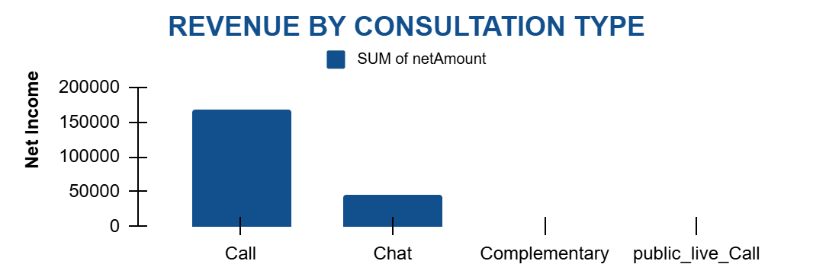
REVENUE BY CONSULTATION TYPE
KEY INSIGHT 1
KEY INSIGHT 2
KEY INSIGHT 3
Call generates the highest revenue at approximately ₹1,68,442, making it the main revenue driver.
Chat contributes approximately ₹45,495, while public_live_Call contributes only about ₹51.
Protecting Call revenue while improving lower-rated services such as Chat can support both profitability and satisfaction.
8

Slide 9
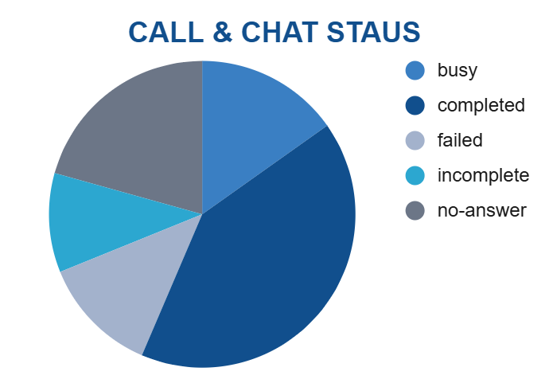
CALL & CHAT STATUS
KEY INSIGHT 1
Completed calls are the largest visible call-status group at 3,453 (about 40.4% of non-missing call-status records).
KEY INSIGHT 2
No-answer accounts for about 20.2%, while Busy and Failed account for about 14.9% and 14.2%.
KEY INSIGHT 3
The non-completed outcomes highlight opportunities for routing, staffing and technical/process improvements.
9

Slide 10
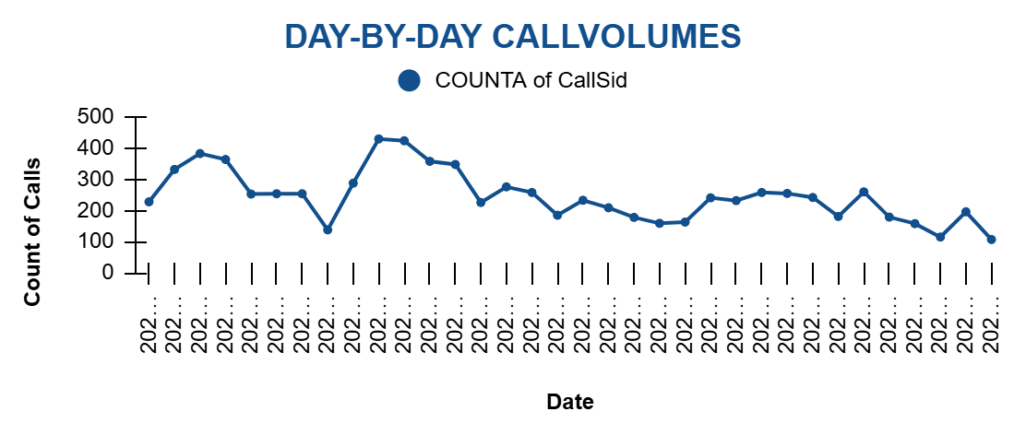
DAY-BY-DAY CALL VOLUMES
KEY INSIGHT 1
KEY INSIGHT 2
KEY INSIGHT 3
Average daily call volume is 246.03 calls across the analyzed dates.
The highest daily volume is 430 calls on 10-Dec-2023, while the lowest is 107 calls on 03-Jan-2024.
Large day-to-day variation supports flexible staffing rather than a fixed staffing level every day.
10

Slide 11
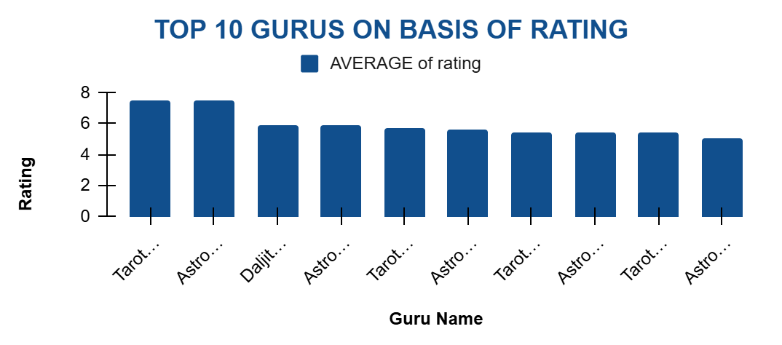
TOP 10 GURUS ON BASIS OF RATING
KEY INSIGHT 1
KEY INSIGHT 2
KEY INSIGHT 3
Astro Pujaa Rai and Tarot Mystical have the highest average rating at 7.50.
Daljit Kaur and Astro Reema follow with approximately 5.95 and 5.90, respectively.
High-performing gurus can be used as benchmarks, while lower-rated gurus can receive targeted coaching.
11

Slide 12
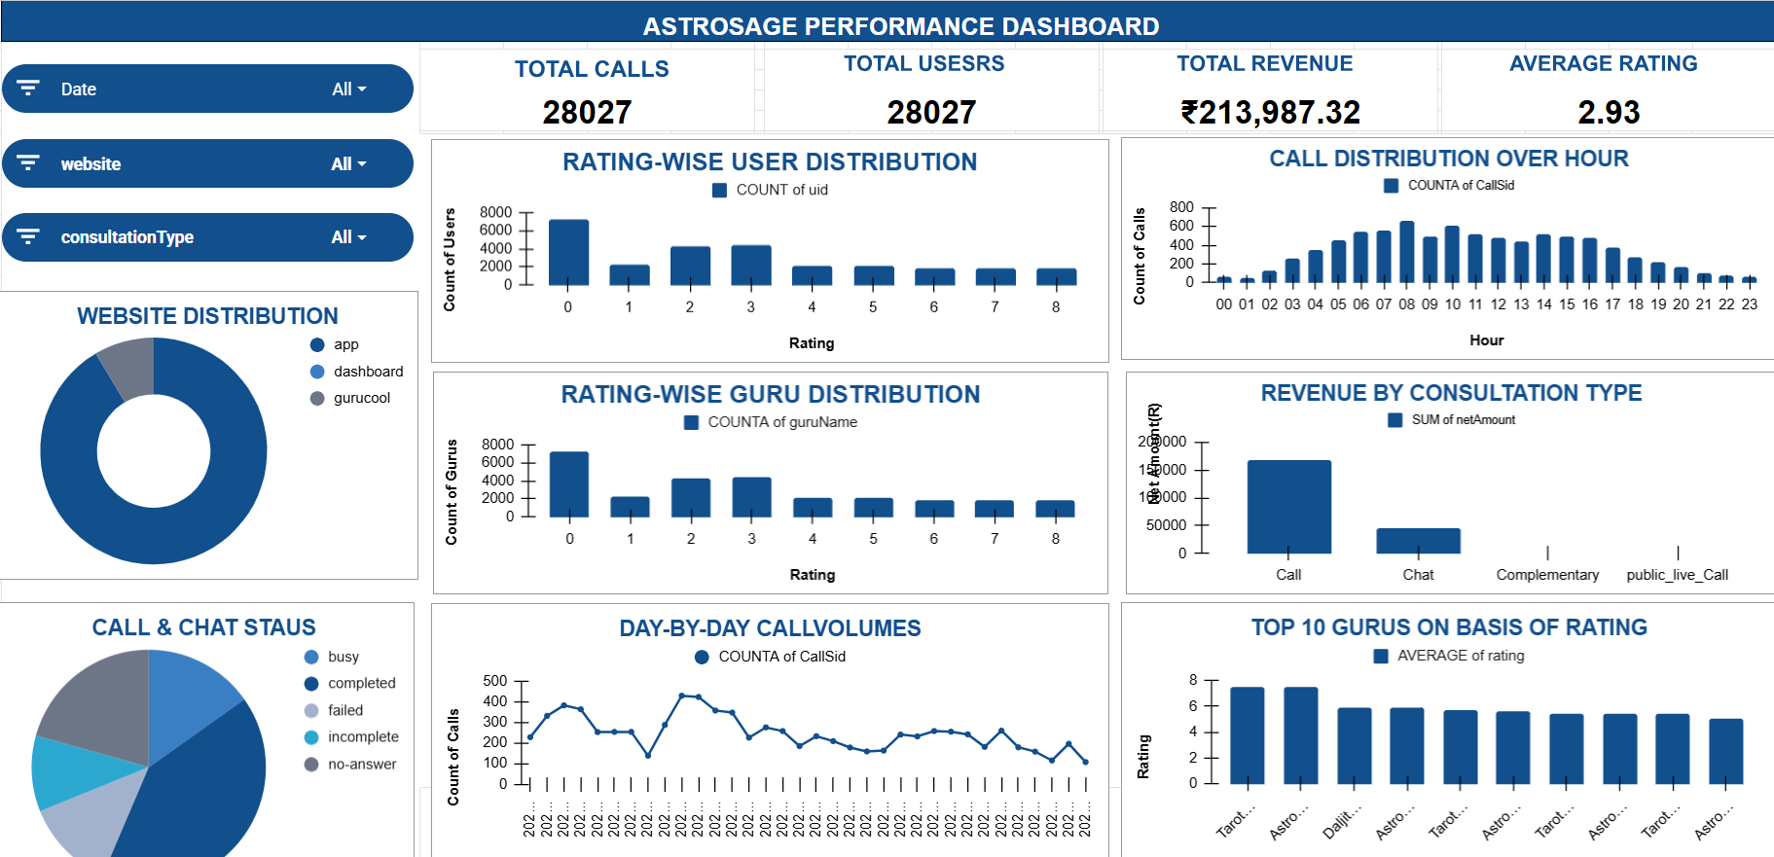
FULL ASTROSAGE PERFORMANCE DASHBOARD
12

Slide 13
RECOMMENDATIONS FROM DASHBOARD
1. Training & Development – ₹45 lakh (45%)
2. Technology & Automation – ₹35 lakh (35%)
Prioritize low-rated gurus and Chat-service training. Target: move overall rating from 2.93 toward 3.5+ and Chat from 2.69 toward 3.2+.
Invest in AI call routing, chatbots, speech analytics, CRM and monitoring. Expected impact: better workload distribution, lower waiting/handling pressure and stronger service monitoring.
3. Peak-Hour Staffing – ₹15 lakh (15%)
4. Workload Balancing
Use hourly call patterns to add capacity during high-demand periods instead of staffing uniformly throughout the day.
Redistribute calls from consistently overloaded gurus to available/under-utilized gurus and use high performers as benchmarks.
5. Protect Revenue While Improving Service
6. Analytics & Monitoring – ₹5 lakh (5%)
Call generates about ₹1.68 lakh of revenue, so maintain its strength while improving lower-rated services, especially Chat.
Track calls, revenue, rating, duration, guru performance and consultation type regularly. Use KPI movement to verify whether the investment is improving efficiency, satisfaction and profitability.
13

Slide 14
CONCLUSION
1
AstroSage handles a large interaction dataset of 28,027 records, with demand varying substantially by hour and day.
2
Customer satisfaction is a major improvement area, with an overall average rating of approximately 2.93.
3
Call is the strongest revenue contributor at approximately ₹1.68 lakh, so profitability should be protected while weaker service areas are improved.
4
Peak-hour and day-level demand patterns support flexible staffing and workload balancing instead of uniform staffing.
5
Guru performance varies widely; high-performing gurus can provide benchmarks and lower-rated gurus should receive targeted coaching.
6
The ₹1 crore investment should prioritize training and targeted technology, supported by staffing improvements and continuous KPI monitoring.
FINAL TAKEAWAY
Invest where the dashboard shows the clearest service-quality and workload gaps, while protecting the strongest revenue-generating activities.
14

